Slide 1
UNIVERSITY MALAYSIA TERENGGANU FACULTY OF COMPUTER SCIENCE & MATHEMATICS WEB BASED APPLICATION DEVELOPMENT CSM3023 MODULE 3 : PROGRAM OFFERING
Prepared for:
DR MOHAMAD NOR BIN HASSAN
Prepared by:
NUR ARIFAH BINTI MOHD HANAFIAH (S66428)
NURHAZIRAH BINTI ABDULLAH (S68144)
MARLIANTI BINTI MUF PIARLIS (S66353)

Slide 2
Introduction
This system's primary duties include submitting new programme proposals, scheduling and revising meetings with relevant parties including JPPU, SENAT, and LPU, evaluating KPT proposals, and updating proposal statuses at every meeting. Every one of these tasks is necessary to have a strong and organised procedure in place.
Furthermore, the proposal must be updated and provided by the Head of the Programme, and it will be sent by the PPPK to the JJPU, SENAT, and LPU, who will arrange and lead meetings to debate the suggestions. The proposal will then be reviewed by the KPT, who will make sure all requirements are satisfied before providing comments or approving it.

Slide 3
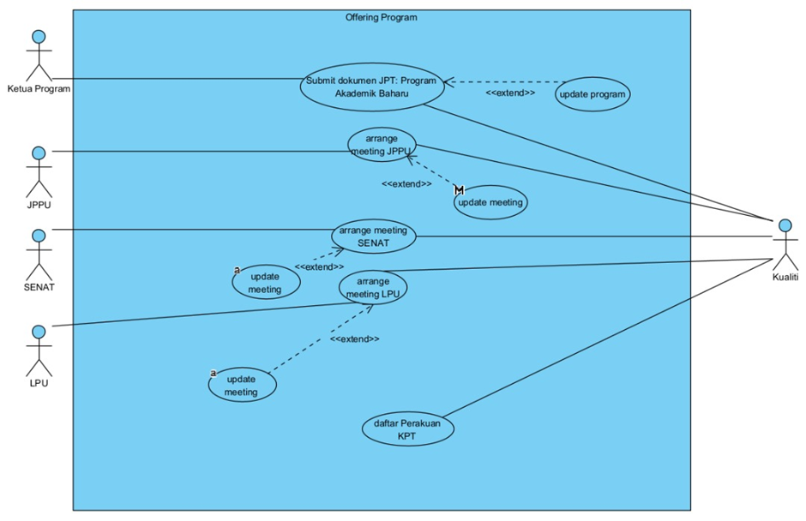
Use Case Diagram

Slide 4
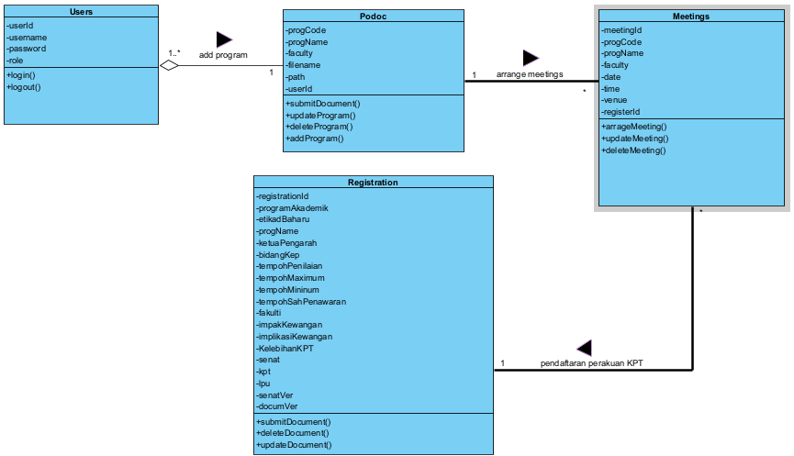
Class Diagram

Slide 5
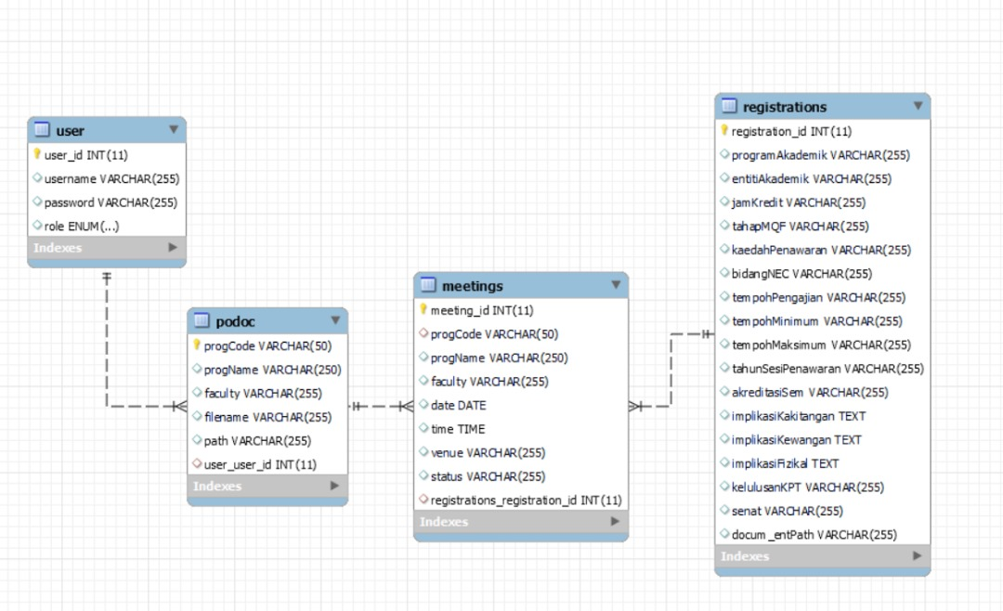
ERD Diagram

Slide 6
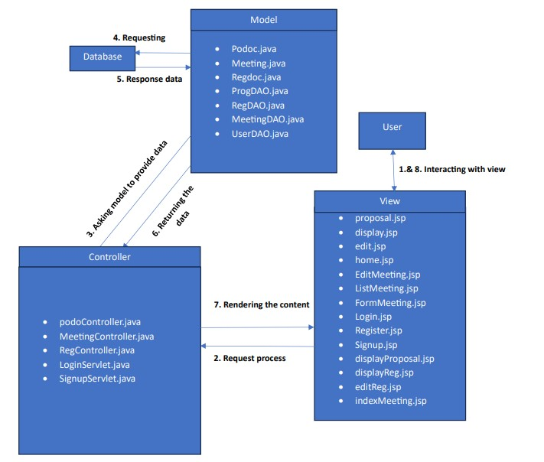
MVC Model

Slide 7
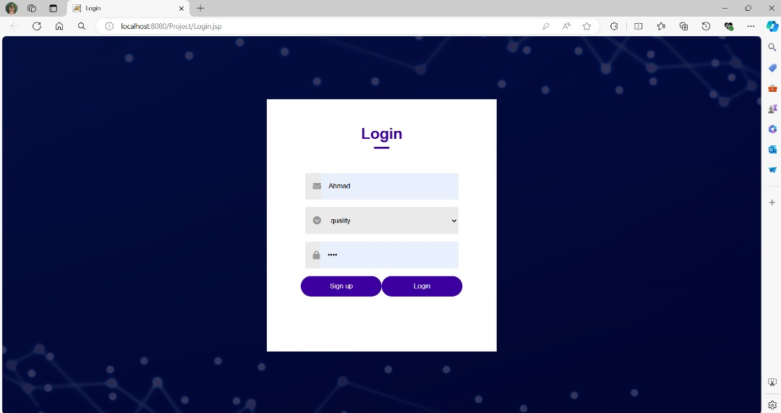
Login

Slide 8
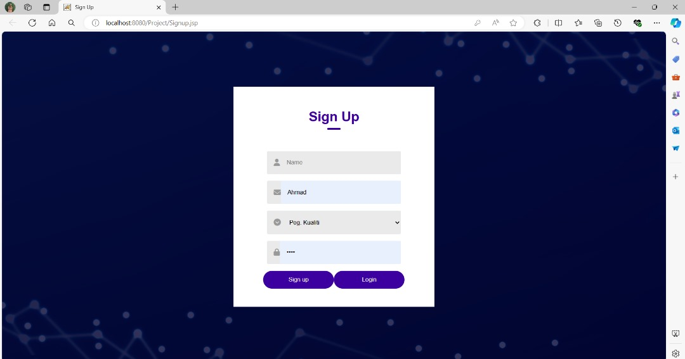
Sign Up

Slide 9
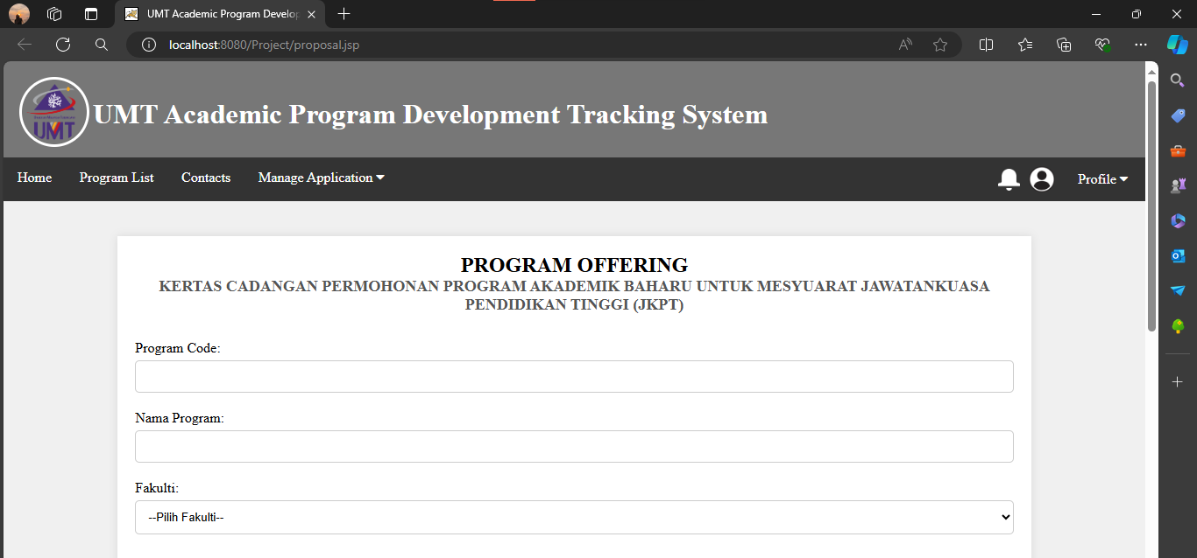
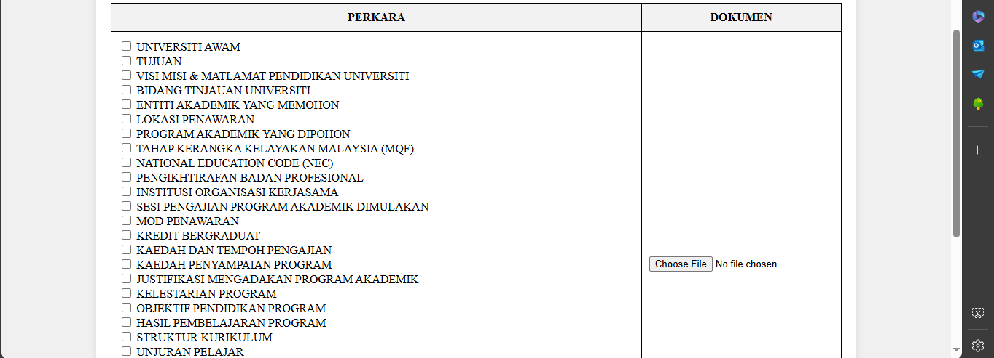
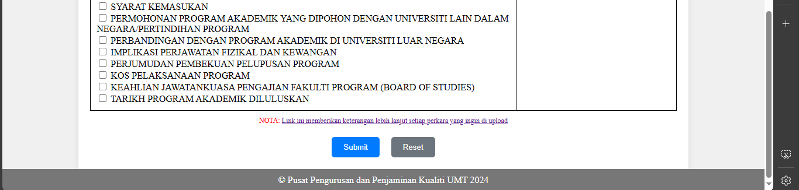
Proposal

Slide 10
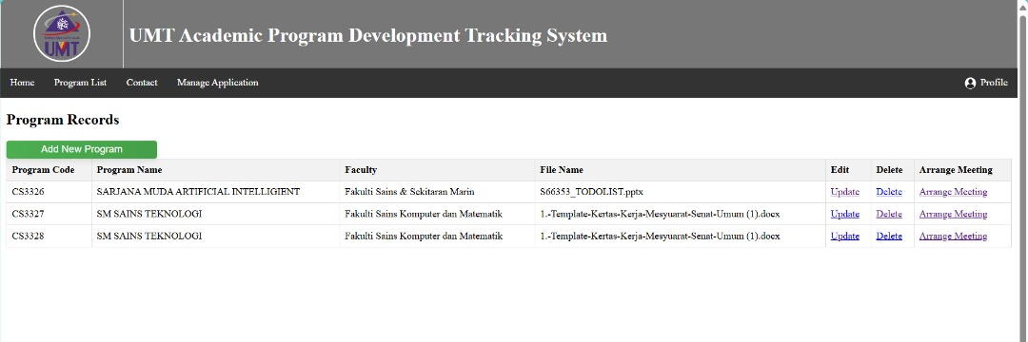
Display Program for Quality

Slide 11
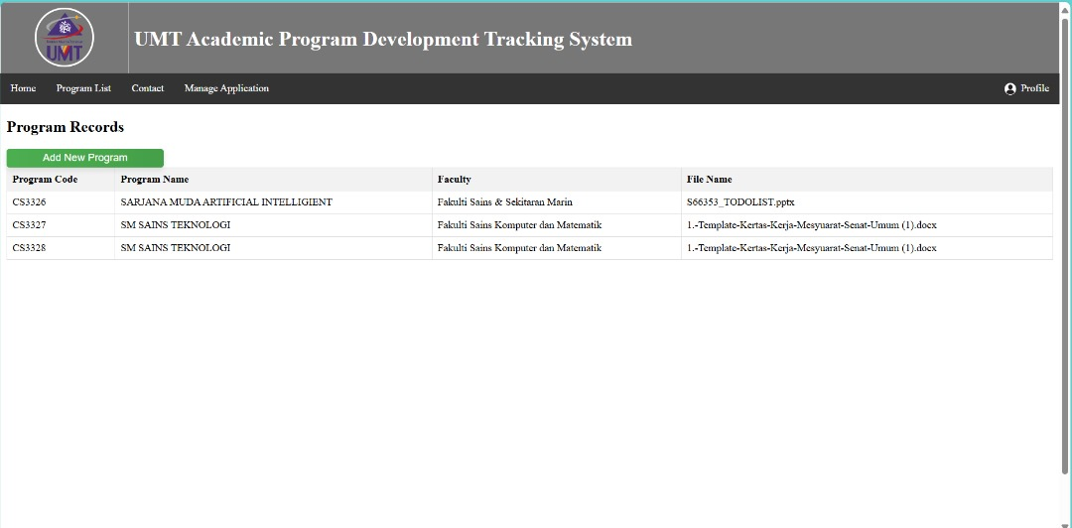
Display Program for Head of Program

Slide 12
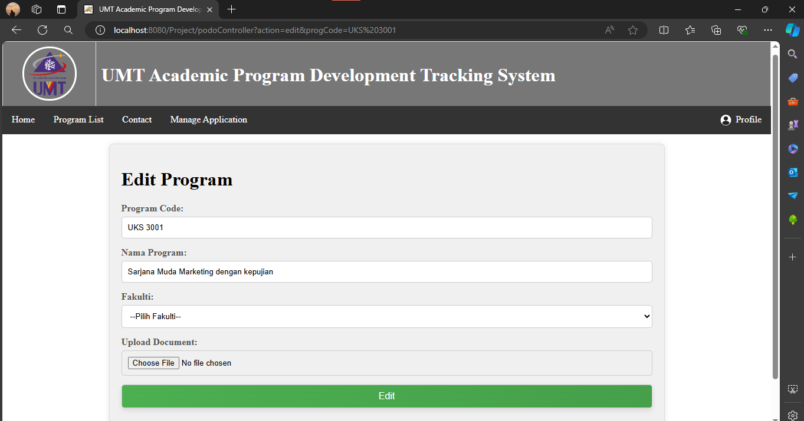
Edit Program

Slide 13
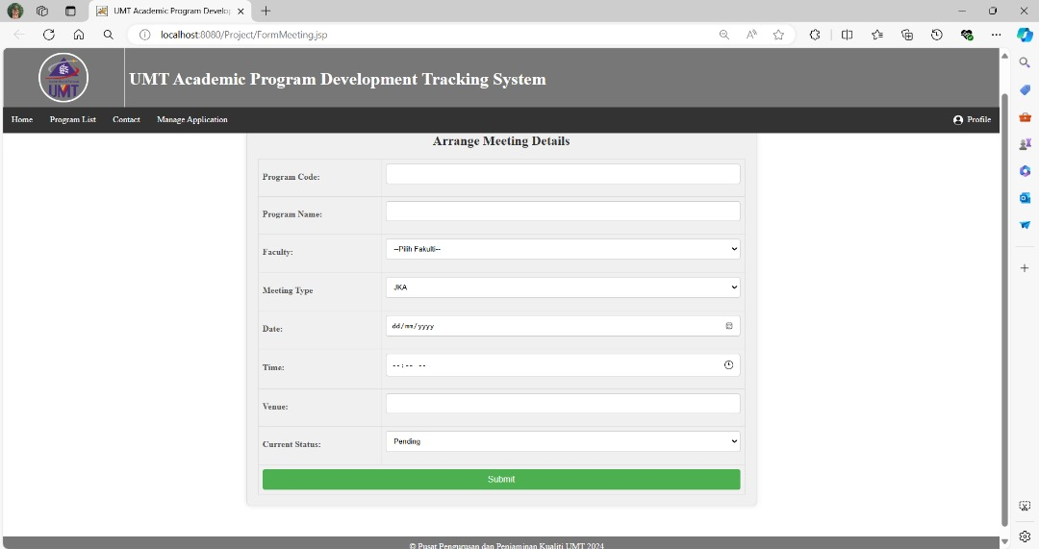
Form Meeting.jsp

Slide 14
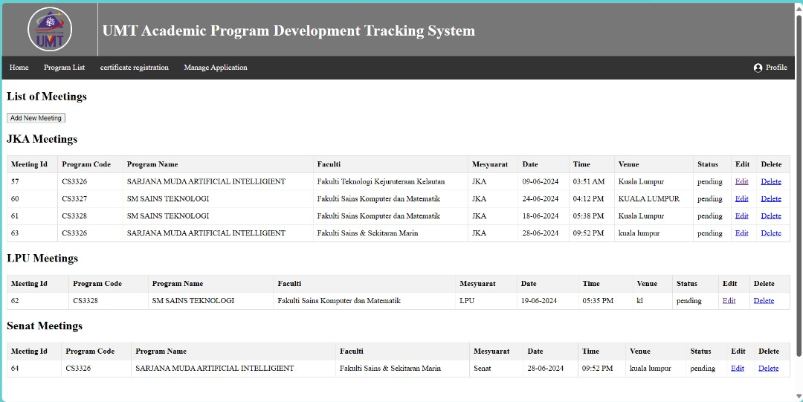
List Meeting.jsp

Slide 15
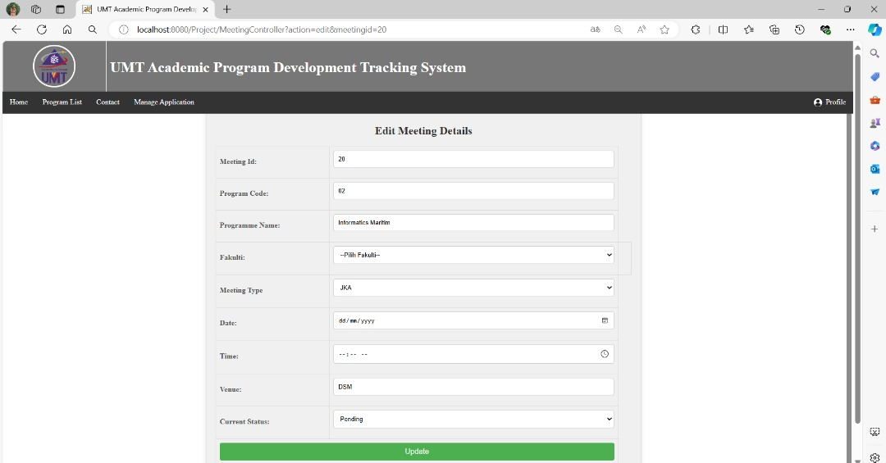
Edit Meeting.jsp

Slide 16
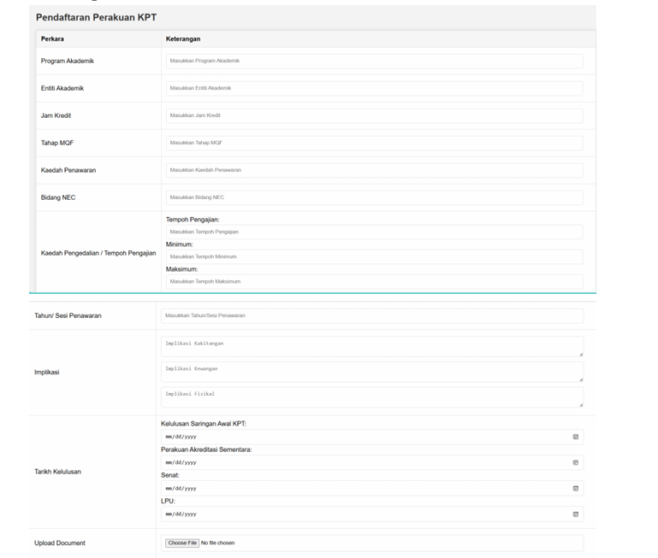
Register

Slide 17
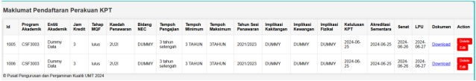
Display Register

